Slide 1
DATABASE MANAGEMENT SYSTEM
CS23332
EXERCISE 1
CREATING AND MANAGING TABLES
ISHWARYA L
241801098

Slide 2
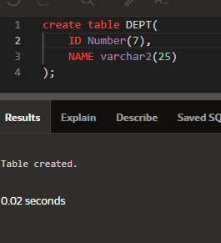
1. Create the DEPT table based on the DEPARTMENT following the table instance chart below. Confirm that the table is created.

Slide 3
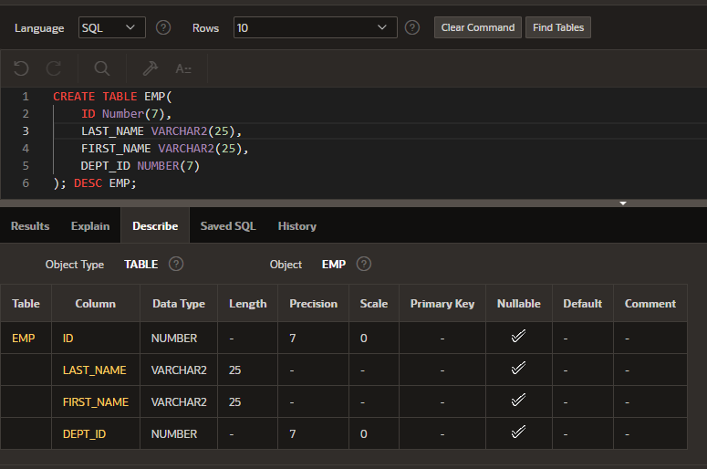
2. Create the EMP table based on the following instance chart. Confirm that the table is created.

Slide 4
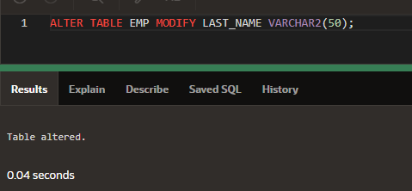
3. Modify the EMP table to allow for longer employee last names. confirm the modification.(Hint: Increase the size to 50)

Slide 5
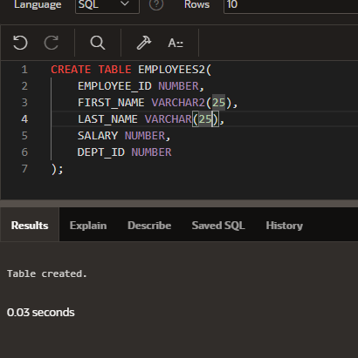
4. Create the EMPLOYEES2 table based on the structure of EMPLOYEES table. Include Only the Employee_id, First_name, Last_name, Salary and Dept_id column. Name the columns Id, First_name, Last_name, salary and Dept_id respectively.

Slide 6
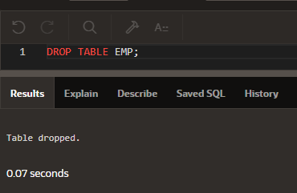
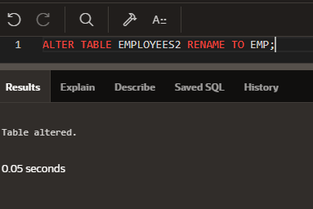
5. Drop the EMP table.
6. Rename the EMPLOYEES2 table as EMP.

Slide 7
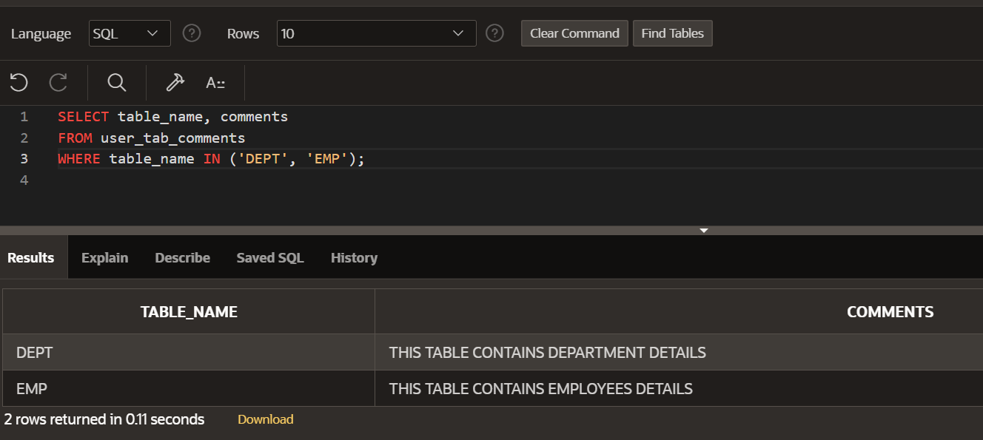
7. Add a comment on DEPT and EMP tables. Confirm the modification by describing the table.

Slide 8
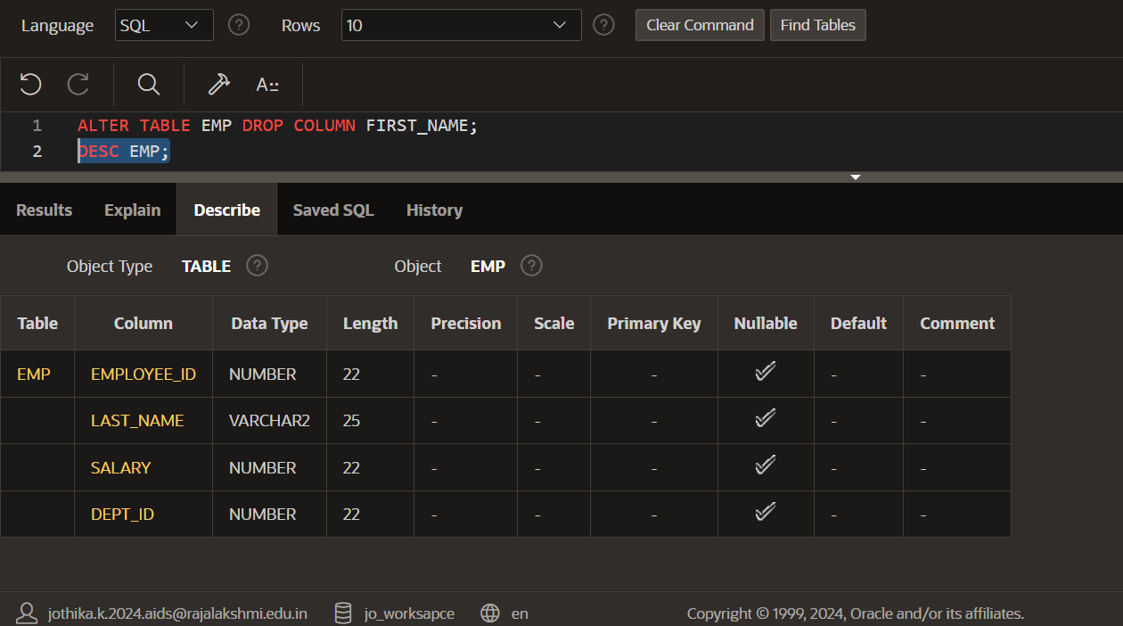
8. Drop the First_name column from the EMP table and confirm it.

